Slide 1

How AI-enabled Microcontrollers Are Expanding Edge AI Opportunities
A Webinar Hosted by:
the Edge AI + Vision Alliance
Speaker:
Tom Hackenberg
Webinar on AI-Enabled Microcontrollers

Slide 2
AGENDA
Common View of AI Scaling
Scope of this WEBINAR IN The Context of Scaling AI
Media Likes to Follow the ‘Newsworthy’ Markets
AI is now a mainstream tool for all Markets
Just like most tools, there is not a one size fits all solution
How is scaling AI Down going to help Solve Ai problems?
scaling AI Down Addresses Issues Brought up by Scaling UP
How Do you run AI in a Microcontroller?
Are MCUs Powerful Enough?
The Core Evolution for AI Scaling
Microcontroller Designers respond to AI Demand
MCU revenue forecast for MCUs Targeting Edge AI Applications
ARM’s Ecosystem For AI MCU Technology
Sample of Shipping AI MCU Based on ARM Technology
RISC-V Ecosystem For AI MCU Technology
Sample Shipping AI MCU targeting EDGE AI Applications on RISC-V
Conclusion
See what Else We Can Offer

Slide 3
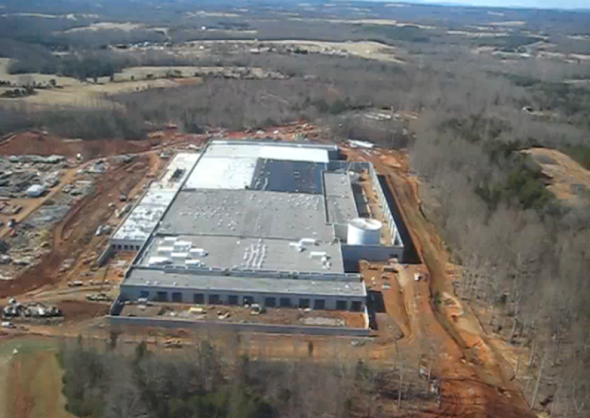
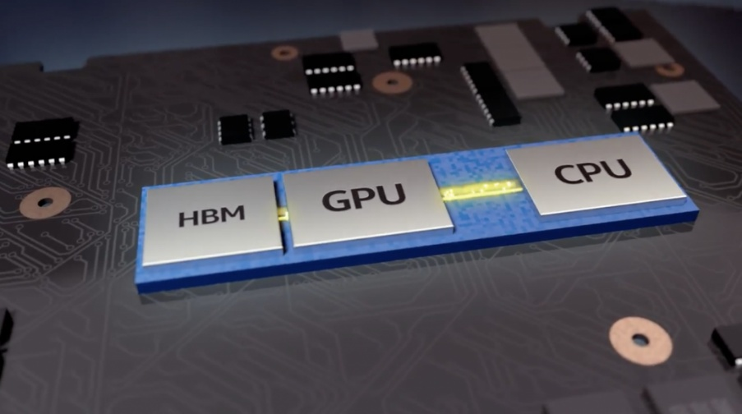

Common View of AI Scaling – More, Bigger, Faster
More Compute, Storage and Networking Demand
Rows and Rows of Racks with servers and networking appliances.
N
More Complex AI Processing Configurations
Hundreds to thousands of watts, up to tens of thousands of dollars
More Data Centers
many demanding as much power and water as a city or small state
Is this all there is to scaling AI? Is it sustainable?
These Photos by Unknown Author are licensed under CC BY-NC-ND

Slide 4
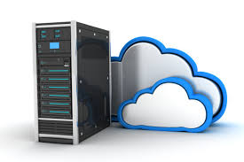

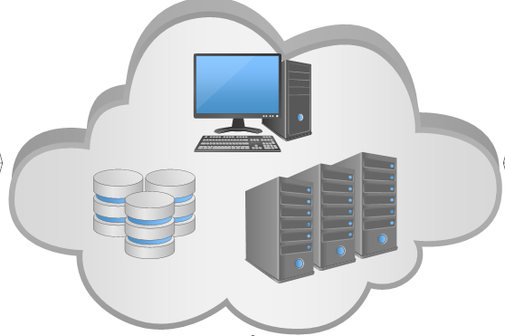




















Scope of this WEBINAR IN The Context of Scaling AI
Centralized computing
Data center
Supercomputer
Thousands of nodes
Upper layer
Cloud Services
Applications, platform, infrastructure, and storage
Three layers of computing:
Upper – Cloud Middle – Comms Bottom – Edge
Cloud gateway
Fog-cloud communication links
Energy consumption and Cooling
Middle layer
Communications
Temporary relevant information, storage, and computation
Latency
Cost
Data Volume
Privacy and security issues
Computing power
Edge gateway
Millions of nodes
Scope
Wireless access point
Radio tower
Intelligent edge nodes
Edge communication links
Edge computing
End-point
devices
Bottom layer
Edge
End-point terminals
Challenges
Challenges
Billions of nodes

Slide 5









Media Likes to Follow the ‘Newsworthy’ Markets
AI in the News again!
Savior or Doom?!
Automotive
Judging by only News cycles, AI is almost ready to drive our cars, replace all our jobs, fill our streams with AI Slop and is poised to either save us, or take over the world!
Cloud & Enterprise Data Processing
Personal Data Processing

Slide 6

Just like most tools, there is not a one size fits all solution
Defense & Aero
Industrial & Other
Performance, national interests, security…
Energy efficiency, data integrity, security, local, environmental, longevity, logistics…
Automotive
Medical
AI is beginning rapid growth in virtually every major market segment
Performance, safety, local environmental, gov’t regulation…
Patient confidentiality, privacy, safety, accuracy…
Telecommunications
Mobility
Bandwidth, reduced latency, security…
Interoperability, environmental, low-latency, longevity, security, logistics…
Cloud & Enterprise Data Processing
Consumer
Performance, customer perception, trust, data protection, government regulation, unlearning…
Cost, local, privacy, security, trust…
Personal Data Processing
Security
Low-latency, cost, energy efficiency, privacy, security, trust…
Security, authentication, encryption, rapid advancement…

Slide 7
How is scaling AI Down going to help Solve Ai problems?
Centralized computing
Data center
Supercomputer
Thousands of nodes
Upper layer
Cloud Services
Applications, platform, infrastructure, and storage
The problems associated with AI are not all likely to be solved by Data Center and Cloud AI tactics of Scaling Up. That is likely to contribute more to existing problems.
Cloud gateway
Fog-cloud communication links
Energy consumption and Cooling
Middle layer
Communications
Temporary relevant information, storage, and computation
Latency
Cost
Data Volume
Privacy and security issues
Millions of nodes
Computing power
Edge gateway
Scope
Wireless access point
Radio tower
Intelligent edge nodes
Edge communication links
Edge computing
End-point
devices
Bottom layer
Edge IoT
End-point terminals
Challenges
Challenges
Billions of nodes

Slide 8
scaling AI Down Addresses Issues Brought up by Scaling UP
Cost – Deploying AI at scale means using affordable hardware. MCUs are orders of magnitude cheaper than GPUs or even CPUs, enabling mass deployment across consumer and industrial applications. This improvement may be limited to applications that can utilize locally obtained or supplied data.
Privacy and Security – Many corporations are now seriously considering the inherent exposure of transmitting in-house data to the cloud. Processing data locally on MCUs or other applications processors, behind locally controlled firewalls, reduces exposure to cloud-based breaches and supports compliance with data protection regulations. Using only local data also reduces unwanted external responses such as hallucinations, misinformation or questionable content.
Computing Power – Edge devices often run on batteries or have strict power budgets. MCUs are optimized for ultra-low power consumption, making them ideal for Edge AI. However, this is a double edge sword in that the types of applications appropriate for Edge AI are vastly more restricted than the wide range of services available through LLMs with access to a full range of web-based data to be trained on.
Energy Efficiency and Cooling – Because of the extremely energy efficient nature of the MCU, there is rarely a need to consider more than simple air cooling and none of the water supply issues becoming an issue with increased data center build out.
Latency – One of the most important considerations for deploying Edge AI solutions rather than cloud-based solutions can be to lower latency. This choice can be based on the deterministic nature of the Edge AI MCU, and/or removing potential communication bottlenecks from the process. This can be critical for safety sensitive applications such as that of an automobile or a cobot.
Data Volume – an often-overlooked advantage of Edge AI processing is the large network traffic issues connecting to cloud-based services with large data requests. Consumed Bandwidth alone can justify the case for investing in Edge AI solutions, many of which can be MCU-based.
Typical Edge AI applications are simple machine sensing of real-world conditions. Many of these are easily implemented on a TinyML platform on an MCU.

Slide 9
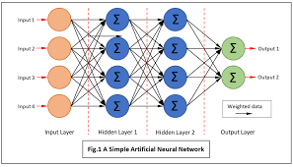
How Do you run AI in a Microcontroller?
To make AI work on MCUs, TinyML is a field of ML using several techniques:
Model Compression:
Quantization: Converts 32-bit floating-point weights to 8-bit integers, drastically reducing size and computation.
Pruning: Removes the model’s unnecessary neurons (connected nodes).
Knowledge Distillation: Trains a smaller model to mimic a larger one.
Efficient Inference Engines:
Libraries like CMSIS-NN (for ARM Cortex-M) and platforms like PyTorch, Keras, LiteRT, TensorFlow Lite for Microcontrollers provide optimized kernels for running neural networks on MCUs.
How TinyML Works on Microcontroller
Images Source: RS Online)

Slide 10

Are MCUs Powerful Enough?
Increasingly overlapping and competing with low-end APU/MPUs. This area is a primary target for AI-enabled processors and microcontrollers.
Performance is increasing more rapidly for MCU’s as they inherit features from other SoC design like multicore and application specific accelerators such as AI.
Power dissipation
APU/eMPU/FPGA
More performance
More power-efficiency
More performance
MCU
Rich OS feature
Multicore MCU
Hybrid MCU
External NAND
More SRAM & NVM
Higher frequency
AI Acceleration
More power-efficiency
Low-power feature
No / low integrated NVM
Cost and Power drive strong 4/8/16-bit core MCU penetration
Performance
$0.10
$1.00
$10.00
$30.00
$100 +

Slide 11
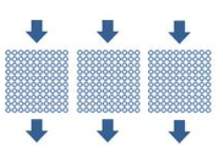
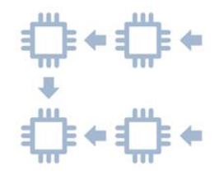
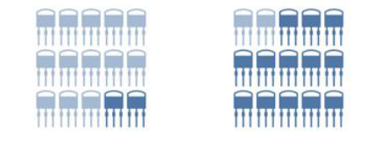
The Core Evolution for AI Scaling
from
General Applications
General workloads
Precise floating-point operations
Sequential or recursive
Scalar Engines
Few powerful cores that tackle computing tasks sequentially
Only allocate a portion of transistors per operation
to
+ Neural Networks
+ Deep learning workloads
+ Integer and adaptive floating-point operations
+ Parallel and SIMD
Platforms and Accelerators
Hundred of specialized cores working in parallel
Most transistors are devoted to parallel adaptive floating-point operations
Scalar to Vector to Matrix processing is about increasing parallelization

Slide 12
Microcontroller Designers respond to AI Demand
Microcontrollers target AI applications with a variety of features
Software Only AI
Software tools are used to optimize code to run machine learning algorithms. This optimization usually starts with selecting target processors or MCUs for best results.
AI Optimized Core
The processor or MCU includes multiple symmetric cores, and an instruction set architecture specifically optimized for ML algorithms. It is almost always used with AI tools to optimize the software but is backward compatible with code designed for classic processors and MCUs as well.
AI Optimized Neural Processing (NPU) Units or AI Accelerators
Vector and/or Matrix extensions, Configurable Logic and other subsystems designed to accelerate the large matrix calculations common to ML.
Notes:
Many classic MCUs incorporate third-party AI algorithms. There are several tools offered by MCU suppliers and third-party vendors to enable moderate efficiency increases running AI algorithms. These are represented here as Software-Only solutions when not accompanied by hardware acceleration, but some form of compact AI platform such as TinyML is almost always used.
a strategy for MCU suppliers to address Edge AI is with core architectures enhanced for accelerating typical AI algorithms. The core complex is frequently multicore. Typical core architectures may include an Arm Cortex M55 or M85 with AI-targeted features.
The third strategy is to integrate an additional application-specific neural processing unit (NPU) or AI hardware accelerator for accelerating more complex matrix multiplications for the more taxing AI applications.
Currently, these Edge AI applications typically target multi-sensor hubs, low-bandwidth image analysis, identification and keyword, or noise analysis applications.

Slide 13

MCU revenue forecast for MCUs Targeting Edge AI Applications
2024 - 2030 MCU revenue forecast, by class of MCU
AI Software Only AI on MCU: CAGR₂₄₋₃₀ = 12.1%
AI Software + AI Hardware Core Technology : CAGR₂₄₋₃₀ = 13.4%
AI Software, + AI Hardware Core and Accelerator Technology: CAGR₂₄₋₃₀ = 22%
Most MCU Suppliers that are developing AI Strategies started early with software solutions, then optimized AI Core Technology, but the use of an accelerator is the fastest growing category.
2030
$2.4B
$6.8B
2024
$2.9B
$2.4B
$1.2B
$2.0B
$0.7B
$0.9B
CAGR₂₄₋₃₀ = 15.4% compared to the overall MCU CAGR at ~ 6%

Slide 14
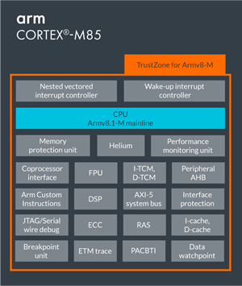
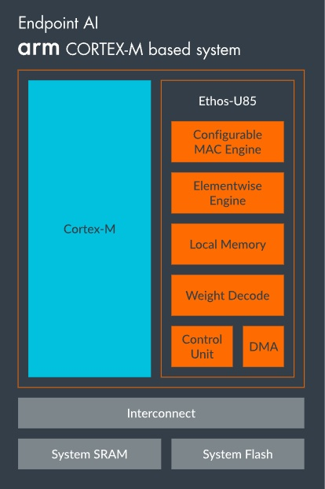
ARM’s Ecosystem For AI MCU Technology
Arm Cortex M, Helium, and Ethos AI acceleration extensions
Helium
enhances CPU-based vector processing.
Ethos handles ML inference with specialized hardware
(All Images Source: Arm)

Slide 15
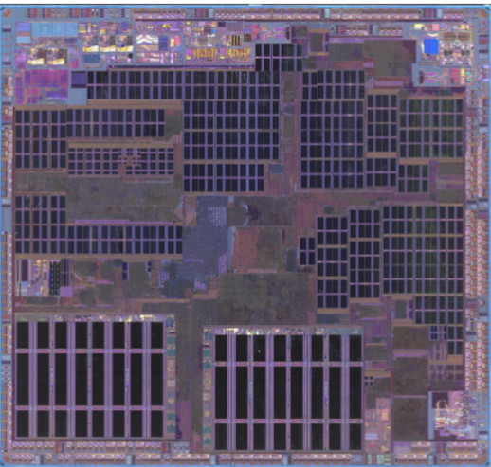
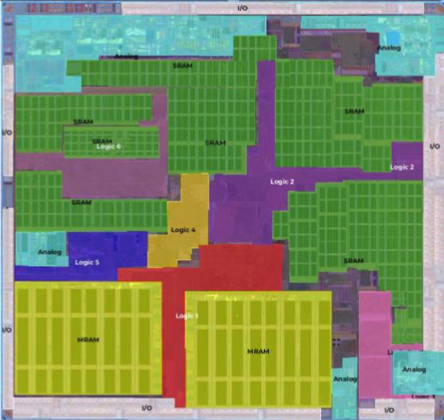
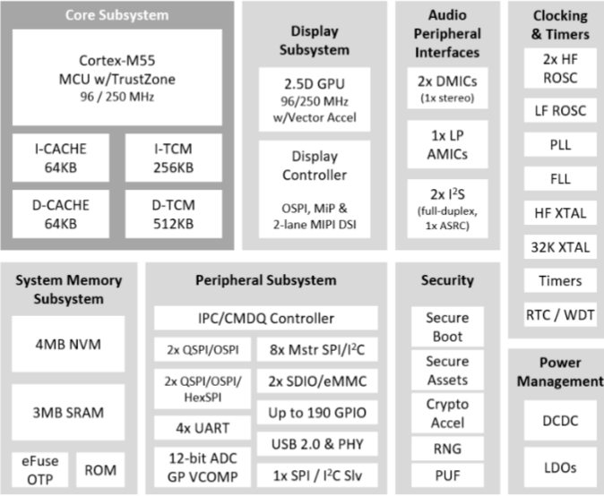
Sample of Shipping AI MCU Based on ARM Technology
Sample of Ambiq Apollo 510, Teardown by Yole Group
Floorplan
Block Diagram
(Source: Yole Group SystemPlus)
Of Note: Cortex M55, GPU, MRAM, and Additional Application Specific subsystems targeting IoT vision and speech.

Slide 16
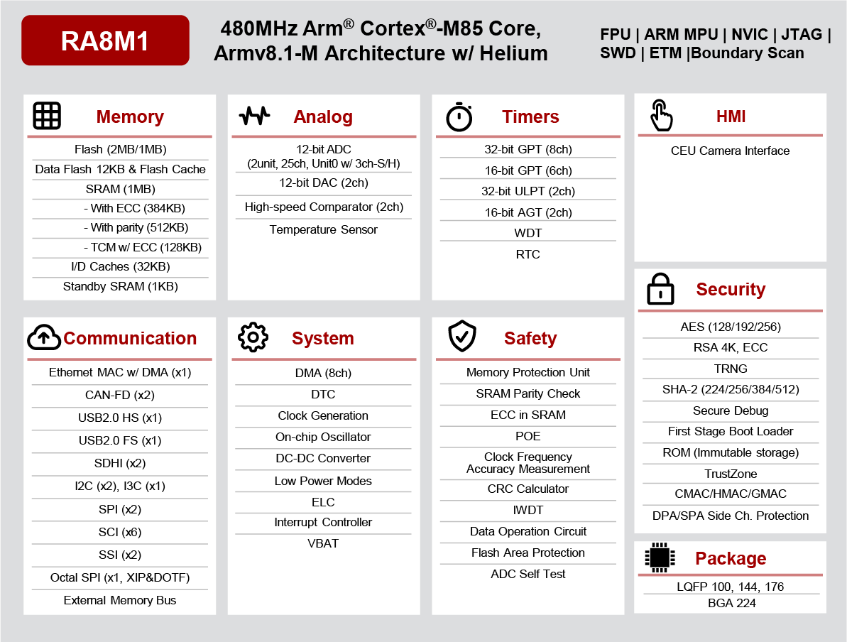
Sample of Shipping AI MCU Based on ARM Technology
Renesas General Purpose Family of AI MCUs based on ARM
Renesas was one of the first leading MCU suppliers to release a general-purpose AI targeted MCU.
They now have several RA8 models in the series of AI targeted MCUs
Though Renesas has a mainstream RISC-V MCU, the family does not yet include AIoT hardware solutions.
(Image Source: Renesas)

Slide 17
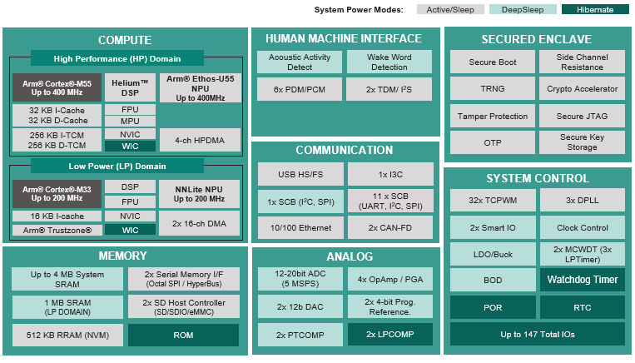
Sample of Shipping AI MCU Based on ARM Technology
Infineon General Purpose Family of AI MCUs based on ARM
The PSOC Edge devices
Cortex M55
Includes Helium
Includes Ethos U55
An additional Cortex M33 with NNLite
(Image Source: Infineon)

Slide 18
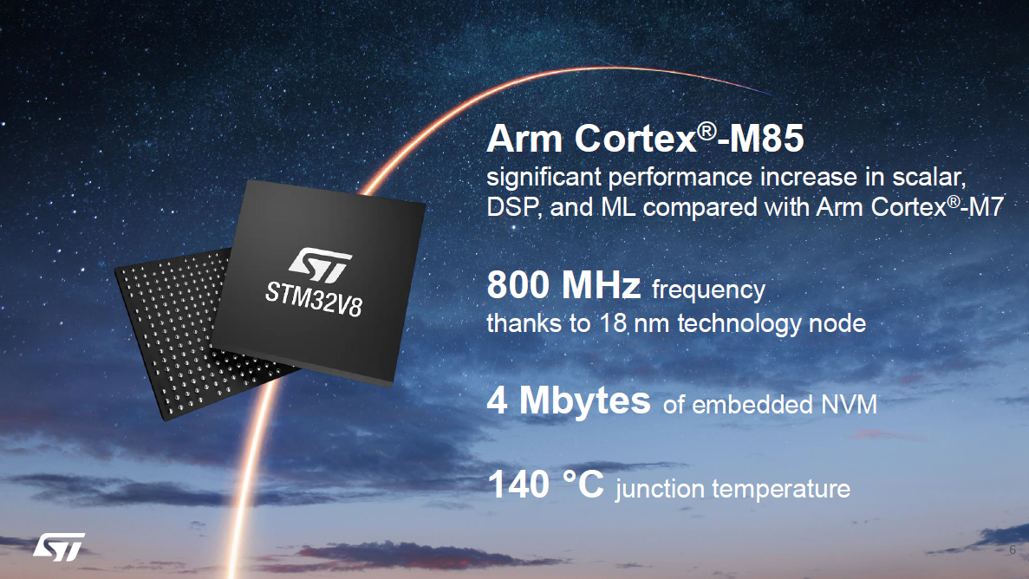
Sample of Shipping AI MCU Based on ARM Technology
New STMicroelectronics Family of AI MCUs based on ARM
STMicroelectronics announced today their new line of STM32V8 MCUs.
It is of note that it includes Arm Cortex M85 AI optimized cores and 4 Mbytes of Phase Change Memory on 18nm.
Large amounts of memory are also crucial to AI performance.
(Image Source: STMicroelectronics)

Slide 19

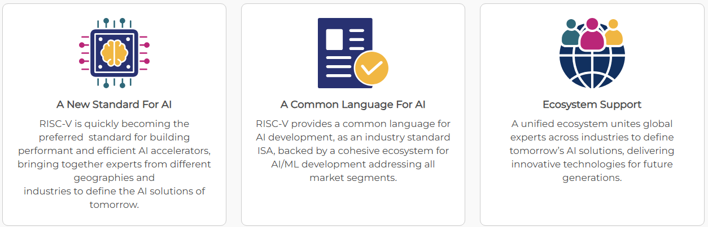
RISC-V Ecosystem For AI MCU Technology
Open Source MCU Core ISA with Matrix Acceleration Engine extensions
The RISC-V ISA has been around since 2011 but didn’t really catch on until managed by the RISC-V Foundation (Now RISC-V International) in 2015. It’s only been the last few years that it has taken off in the MCU market. Unlike ARM with very controlled architectures, RISC-V is open source and customizable so there are no block diagrams to show here. There is now an ecosystem of designers providing a variety of core designs or design services. The
RISC-V as a target for AIoT is only a couple of years available for design in the market now with the addition of the SIMD, Matrix Multiplication and other extensions to accelerate ML. At this time, there are several IoT solutions, but we’ve discovered only one AIoT MCU. It is from UpBeatTech using SiFive core designs.
(All Images Source: RISC-V International)

Slide 20
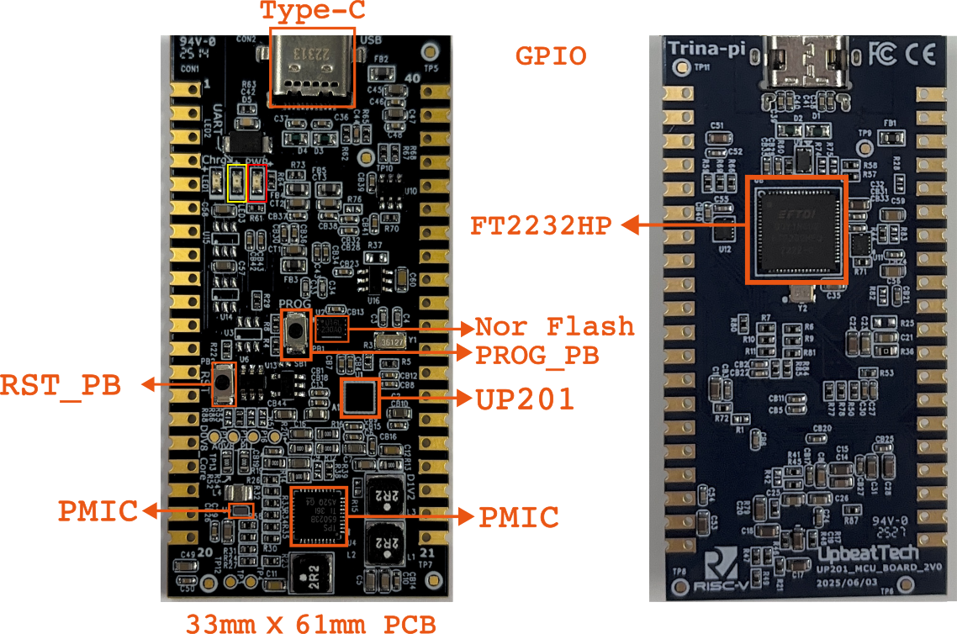
Sample Shipping AI MCU targeting EDGE AI Applications on RISC-V
UpbeatTech 201/301 MCU with SiFive RISC-V Core IP
Of note is energy efficiency rated at 16.8 uW/MHz/DMIPS (Dhrystone) according to SiFive.
(Image Source: UpBeatTech)

Slide 21



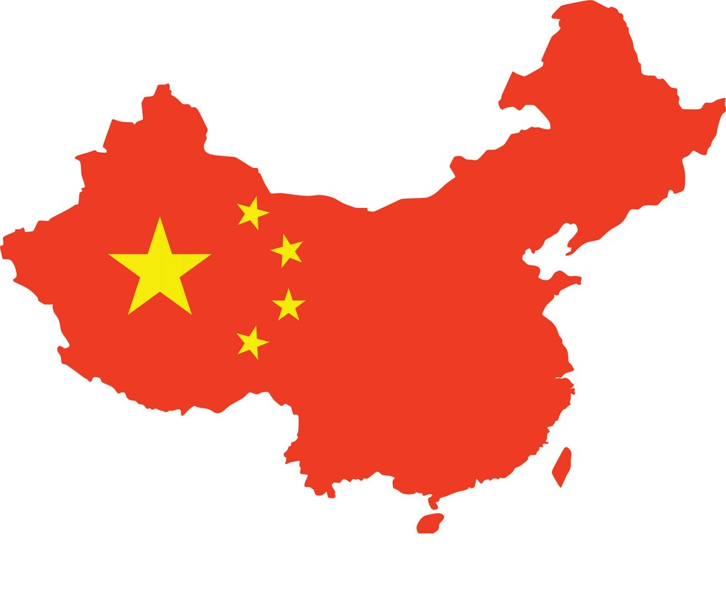

















China’s MCU Fabless Designer landscape
A map of the fabless microcontroller designers in China
non-exhaustive list!
Geopolitical tensions and the desire to lessen dependence on foreign sources drive a growing list of MCU suppliers in China. Many of these are exploring RISC-V AIoT MCUs.
Beijing
Suzhou
Nanjing
Wuxi
Shanghai
Hangzhou City
Shenzhen

Slide 22
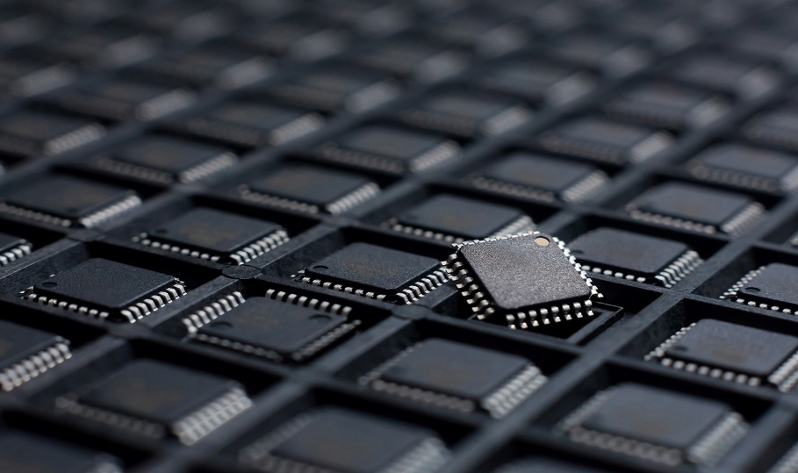
Conclusion
Scaling Down has both application benefits and is a mitigating factor for Scaling Up
Scaling Up is part of the problem with AI
Conclusion
Scaling Down is part of the Solution
reduces the cost of small AI applications
increases privacy and security by keeping the process local
Distributes demand for compute power to smaller, manageable hardware.
Reduces environmental impact by reducing reliance on large energy and cooling hungry cloud-based data centers
Reduces latency and reliance on external infrastructure
Reduces network traffic
Several top suppliers already have products
A 15% CAGR from 2024 to 2030 reaching almost $7B
Images Source: RISC-V International)
Image Source: YoleGroup)

Slide 23

See what Else We Can Offer

Slide 24
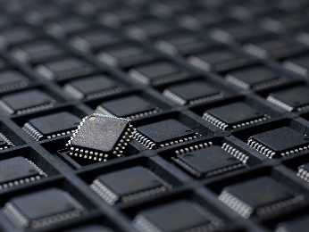
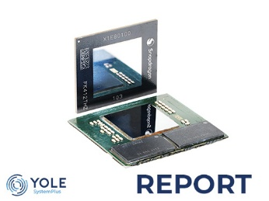

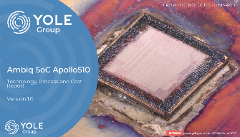
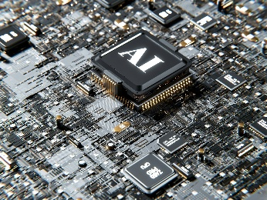
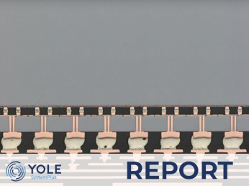

Related Reports and Teardowns
Status of the Microcontroller Industry 2025
AI Processors for Consumers Apple M4 and Qualcomm Snapdragon X-elite comparison
Computing and AI for Automotive 2025
Ambiq SoC Apollo510 2025
Generative AI 2025 - Impact on Processors, Memory, Advanced Packaging, and Substrates
Nvidia H100 Tensor Core GPU
Generative AI 2025 - Computing and AI for Data Center
And many more

Slide 25

How to use our data?
Yole Group, including Yole Intelligence, Yole SystemPlus and PISEO, are pleased to provide you a glimpse of our accumulated knowledge.
Please note that the entire document and its data is copyrighted © Yole Group 2025.
To share our data with your own network, within your presentations, press releases, dedicated articles and more, please contact our Public Relations department to make sure you get up-to-date, licensed materials.
We will be more than happy to provide you our latest results and appropriate formats of our approved content.
Public Relations & External Communications publicrelations@yolegroup.com
Visit our website: www.yolegroup.com

Slide 26

ssssssssssssssss
The Edge AI and Vision Alliance is a partnership of ~100 leading edge AI and vision technology and services suppliers, and solutions providers
The Alliance provides high-quality technical educational resources for product developers
Register for updates at www.edge-ai-vision.com
The Alliance enables edge AI and vision technology providers to grow their businesses through leads, partnerships, and insights
For membership, email us: membership@edge-ai-vision.com

Slide 27

Join us at the Embedded Vision Summit May 11-13, 2026—Santa Clara, California
The only industry event focused on practical techniques and technologies for system and application creators
“Awesome! I was very inspired!”
“Fantastic. Learned a lot and met great people.”
“Wonderful speakers and informative exhibits!”
Summit highlights:
Inspiring keynotes by leading innovators
High-quality, practical technical, business and product talks
Exciting demos, tutorials and expert bars of the latest applications and technologies
Visit www.embeddedvisionsummit.com for updates

